Slide 1

So What Is Data?
“From bits to information”

Slide 2

Outline
Data Formats.
Unstructured, semi-structured and structured data.
Splunk parsing.
Bits, bytes, numbers and characters.
Encoding and Compression.
Magic Numbers.

Slide 3
Data Formats
“From bits to information”

Slide 4

Outline
The Who? The What? Where? When? Why?
Text, Documents, Images, Sounds, Video.
Local dates: 5 Mar 2020, 5/03/2020, 03/5/20.

Slide 5
Unstructured, Semi-Structured and Structured.
“From bits to information”

Slide 6

Unstructured and Structured
Unstructured. Within this type of data, there is no real formal structure defined for the data elements, and where we must use keywords, and to provide pointers to interesting data elements.
Semi-structured. This type of data has some defined structure, and includes tags and/or markers that identify the semantic elements, or which provide a form of hierarchy in the data. Examples of this form include XML and JSON, and where there is some structure, but where it is not bound to a formalised data definition. The structure itself does not have to be in a table form, But could use a NoSQL (non-SQL) approach to storing data elements. Within NoSQL we can have multiple formats for our data, such as using key-value data elements.
Structured. This defines a formal schema and has associated data models or a formal relational structure. Included within this are the encoding methods used and the fundamental definition of the entities, and the relationships between each of the entities and actions.

Slide 7
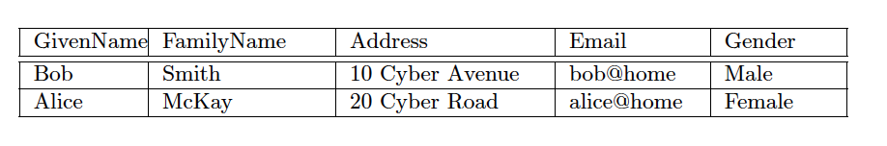
Unstructured and Structured
Unstructured: Bob Smith is male and lives at 10 Cyber Avenue, and has an email address of bob@cyber. Alice McKay resides at 20 Cyber Road. She is female, and you can contact her at alice@home.

Slide 8
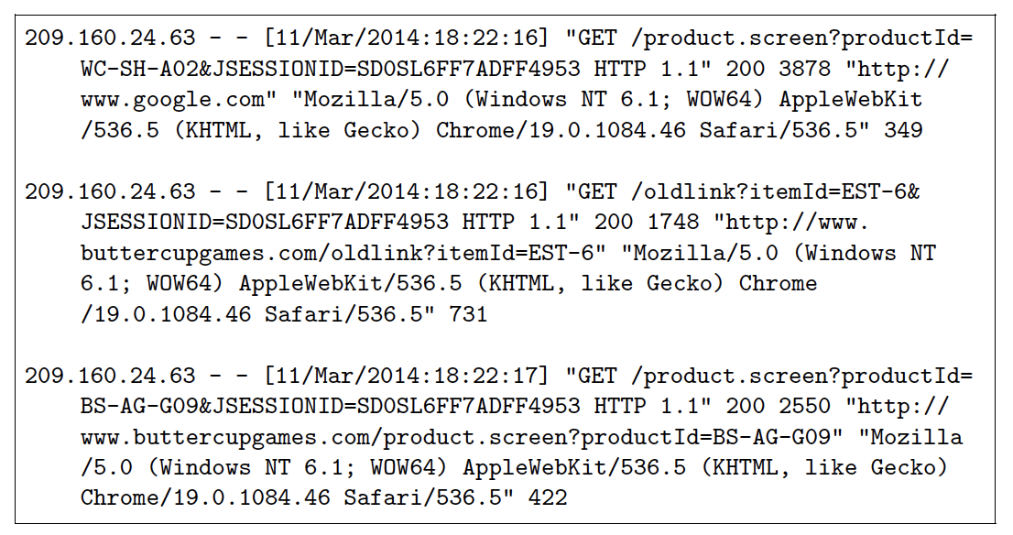
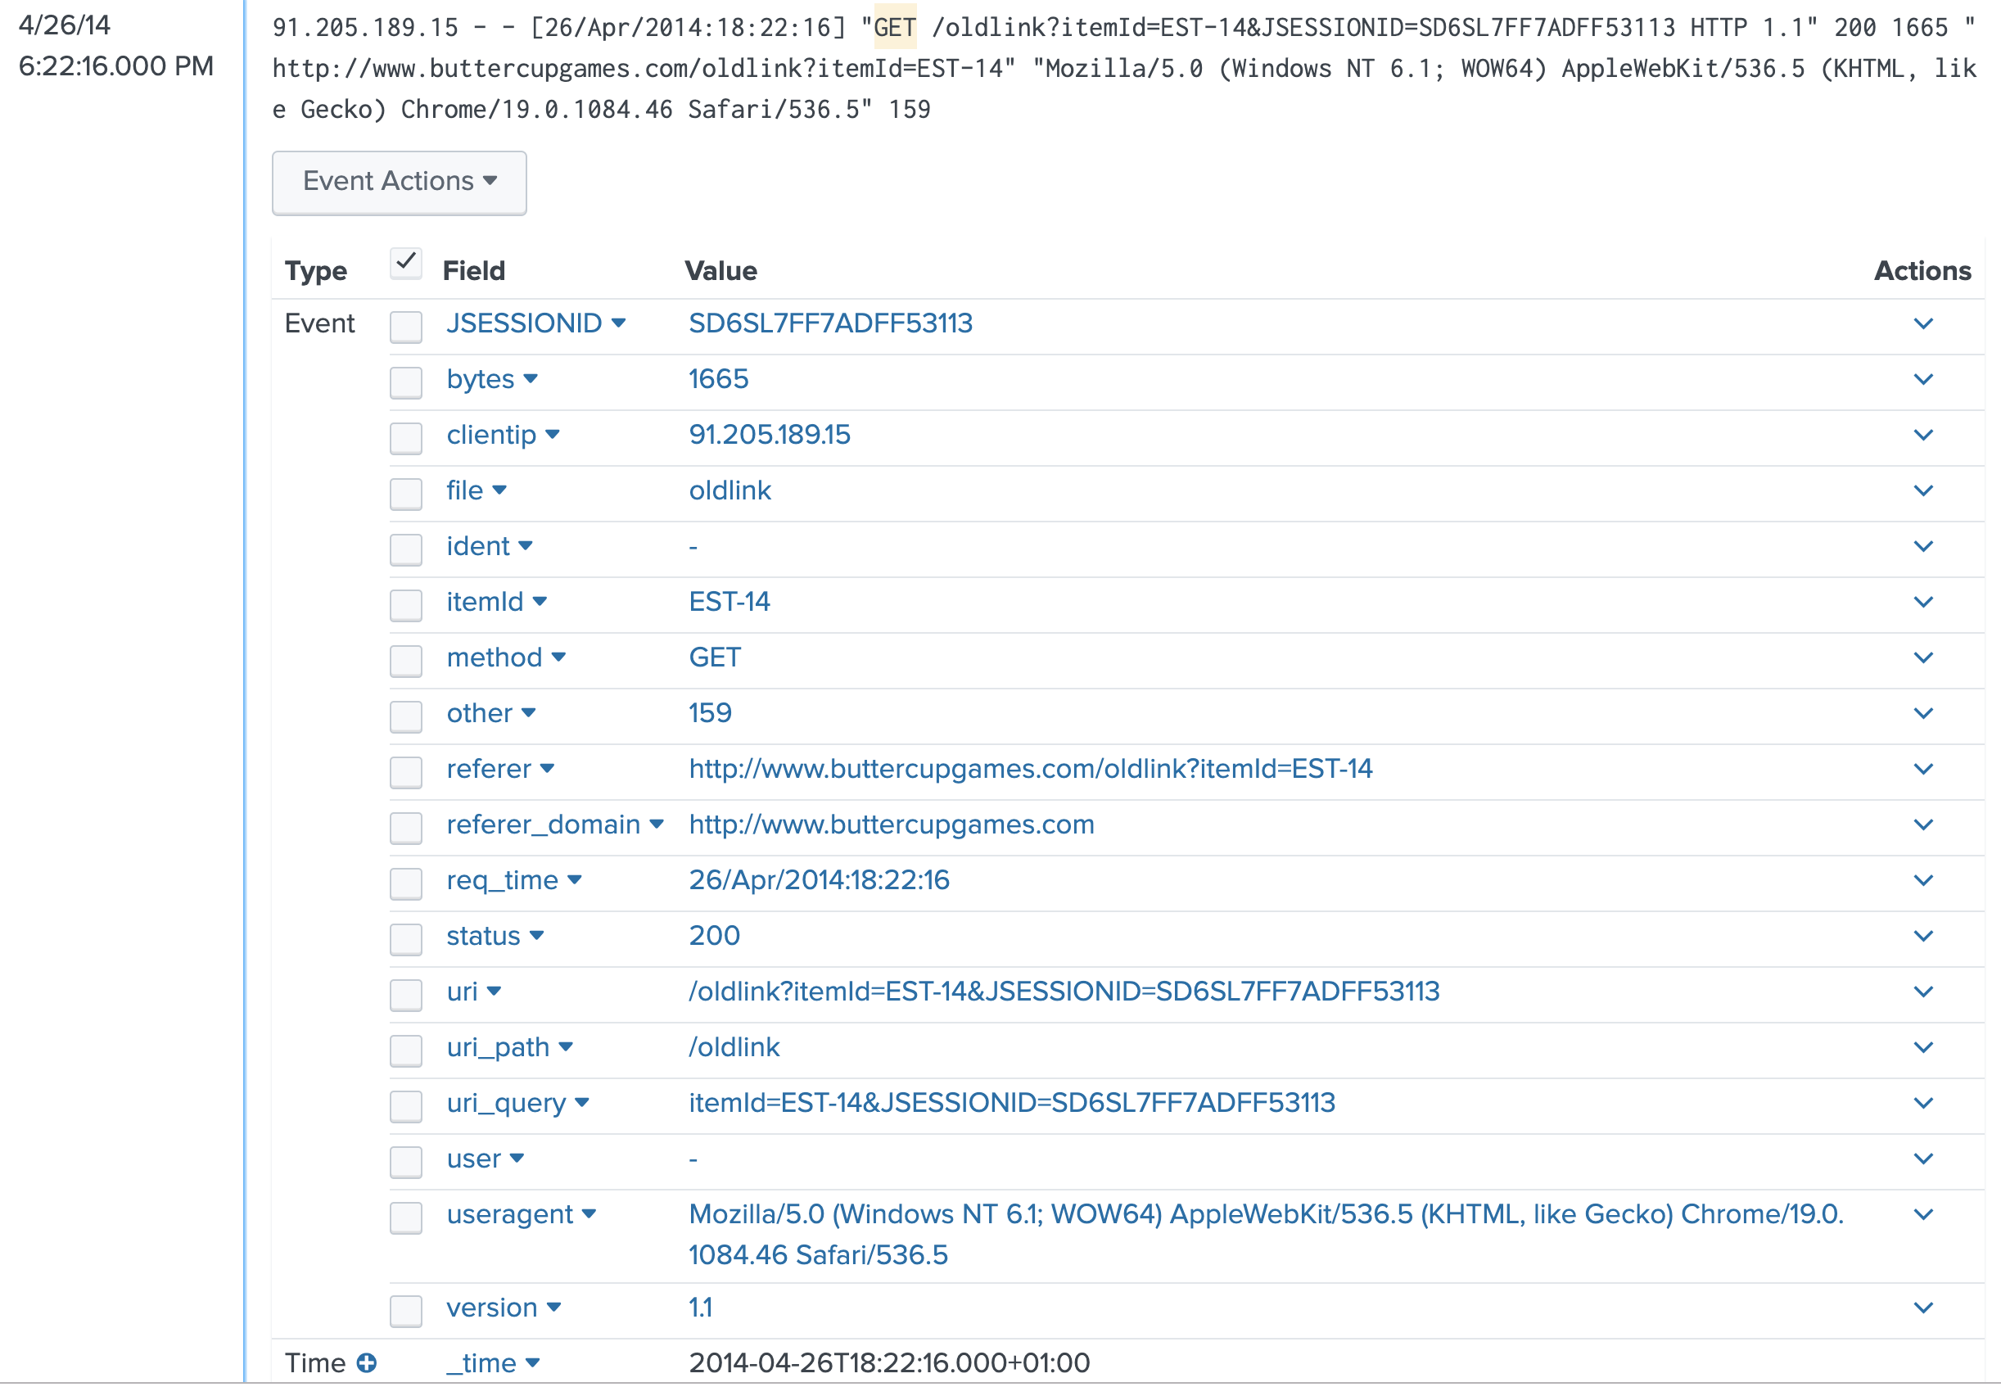
Splunk Parsing

Slide 9
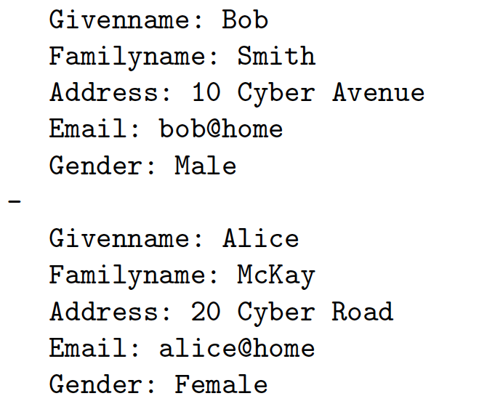
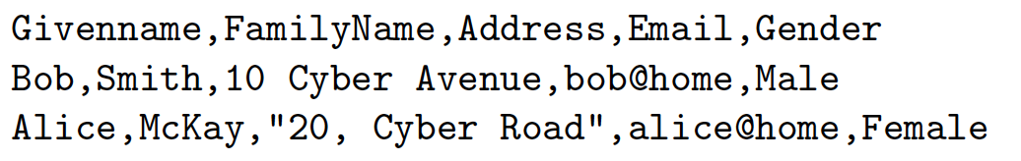
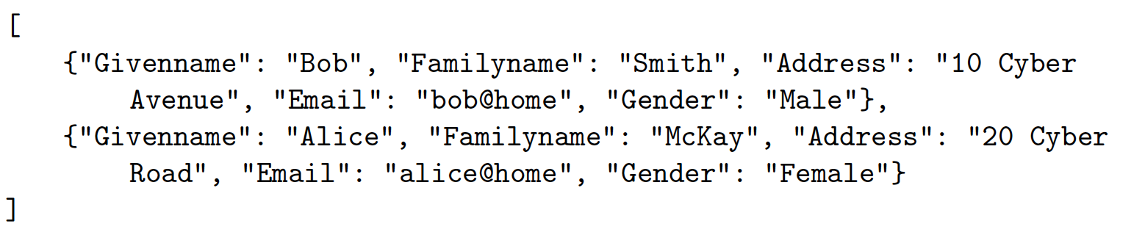
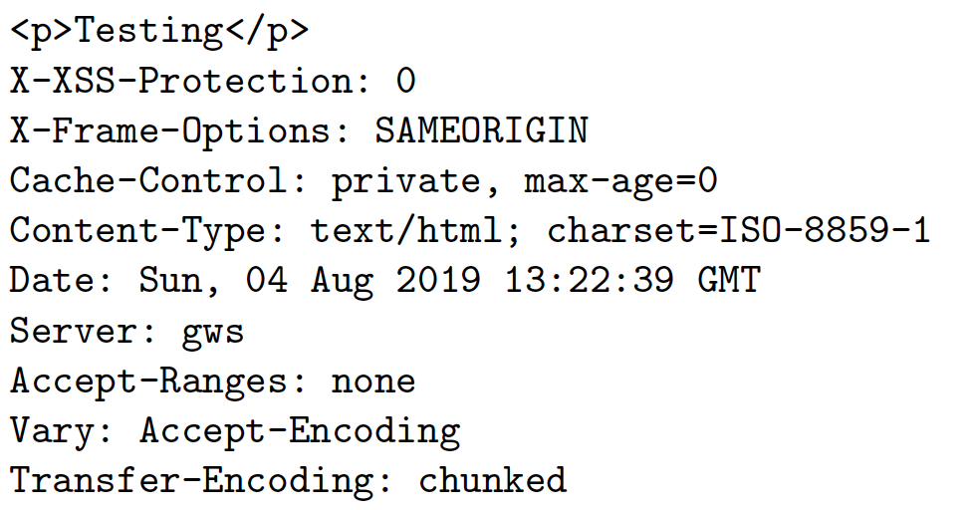
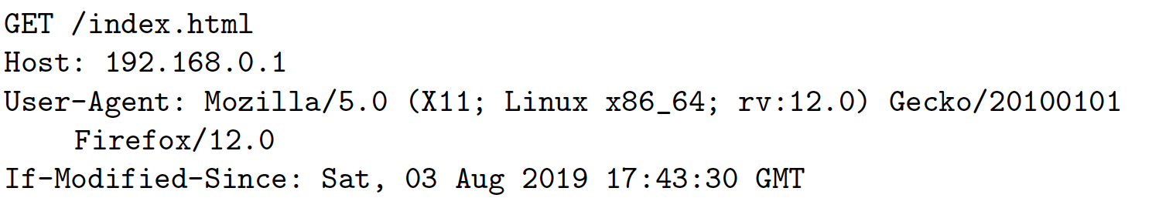
CSV, YAML and JSON

Slide 10
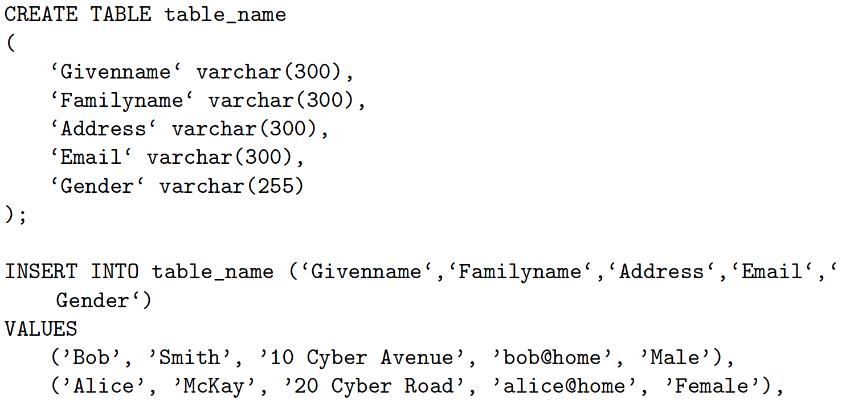
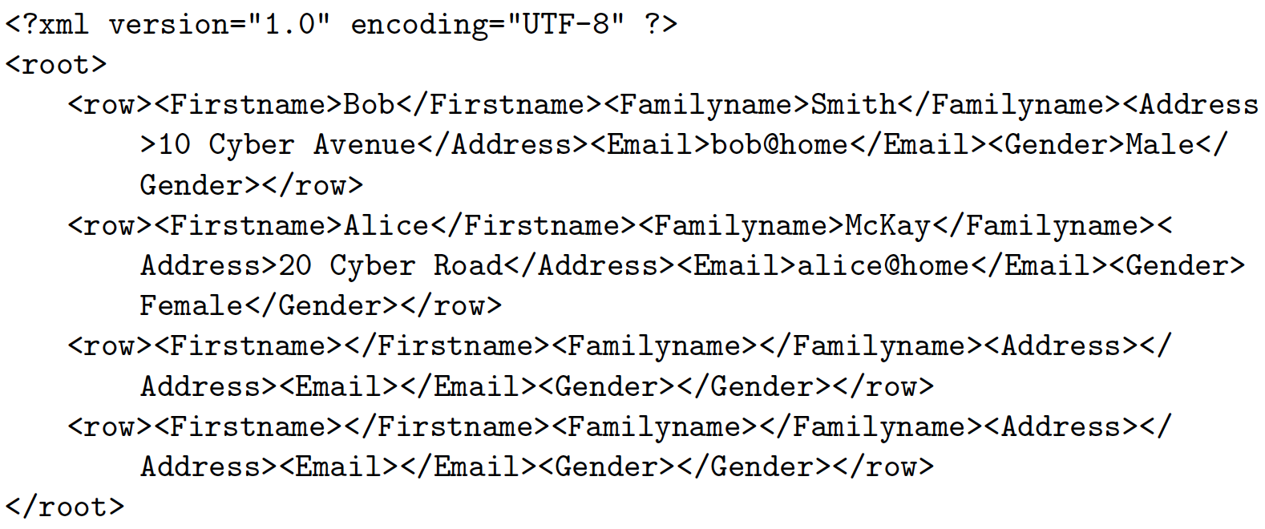
SQL and XML

Slide 11
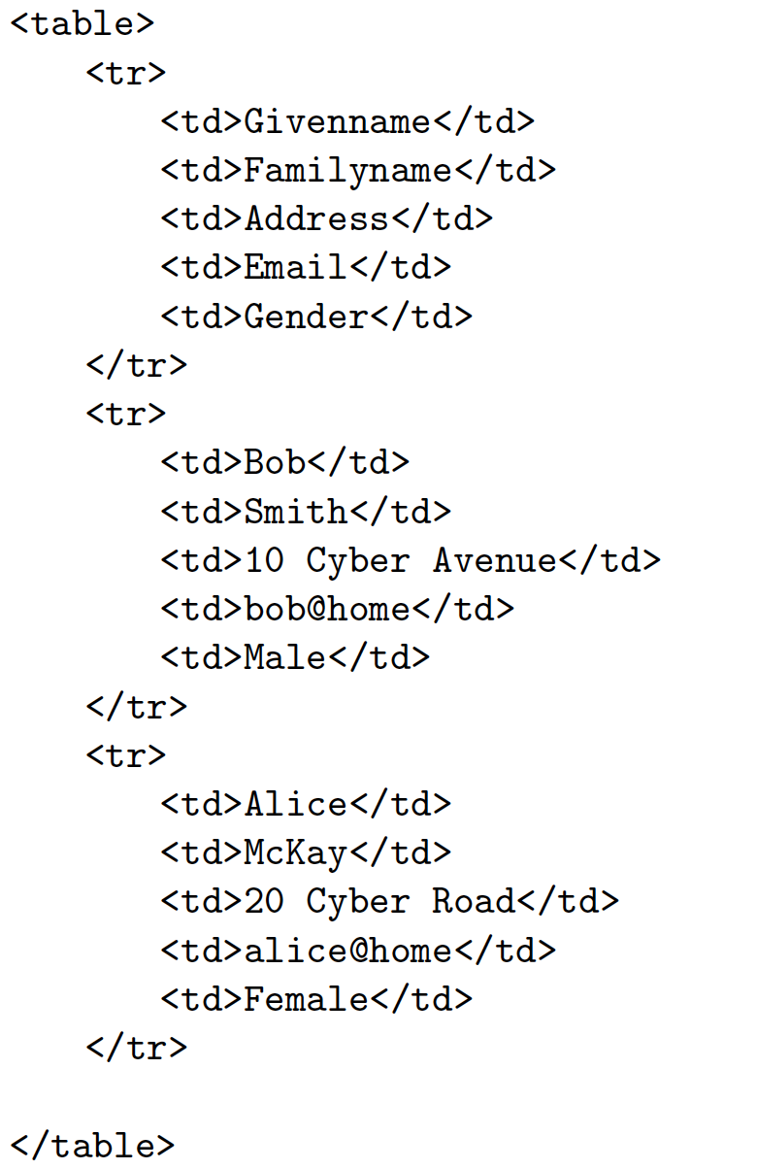
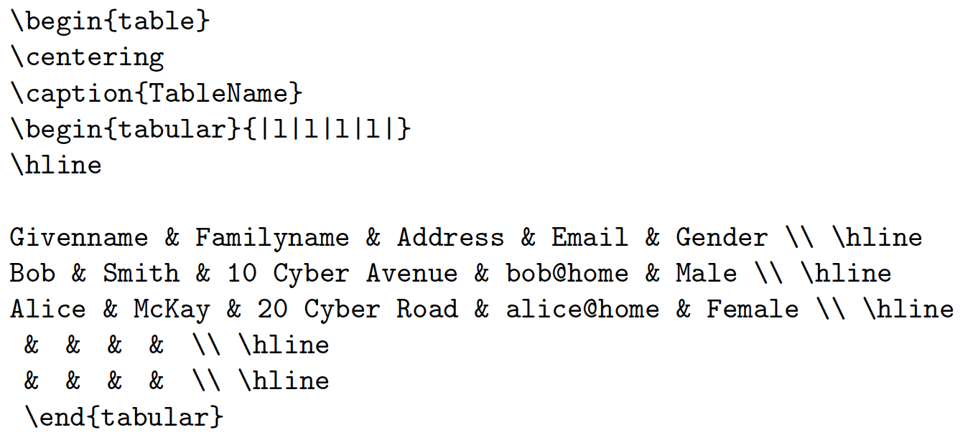
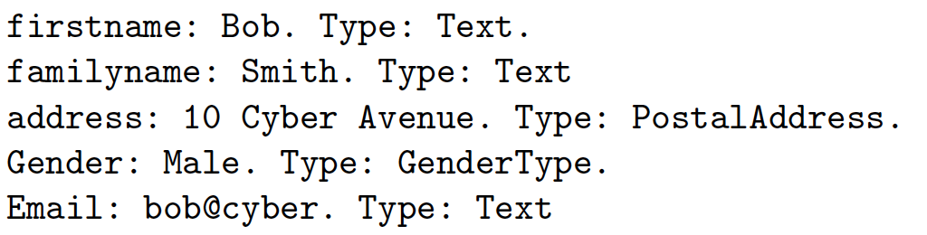
HTML and LaTeX

Slide 12
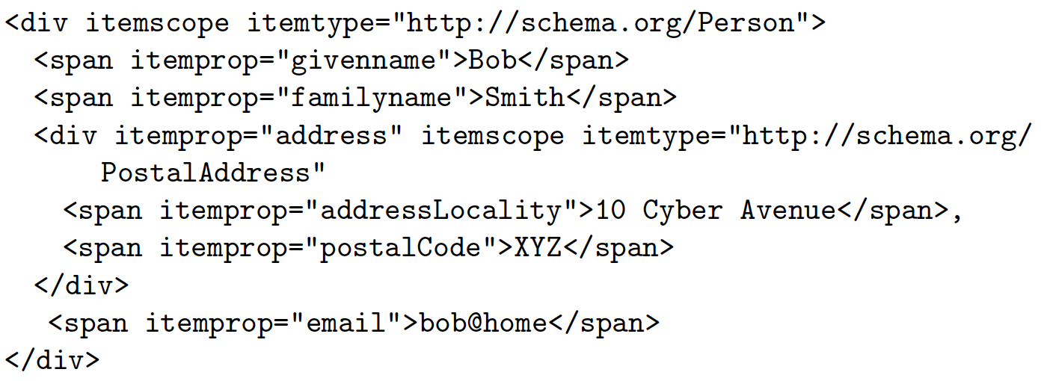
Schema

Slide 13
Bits, Bytes, Numbers and Characters
“From bits to information”

Slide 14
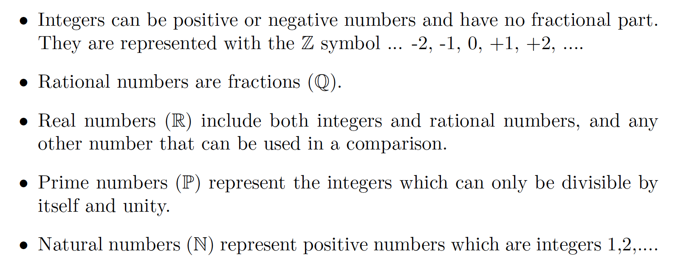
Numbers

Slide 15
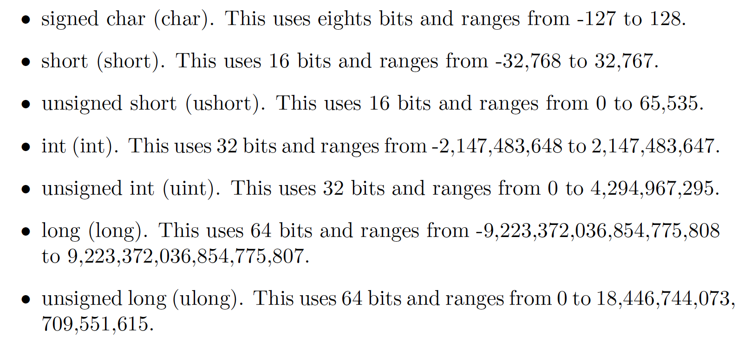
Numbers

Slide 16
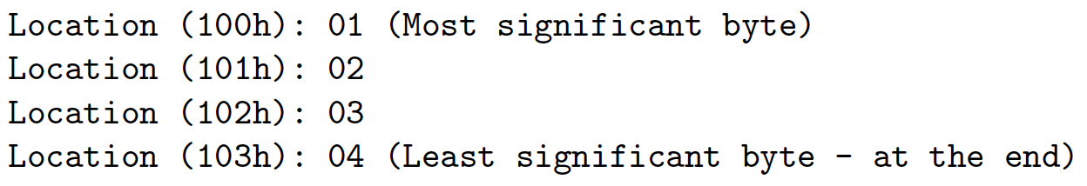
Little and Big Endian

Slide 17
Encoding and Compression
“From bits to information”

Slide 18
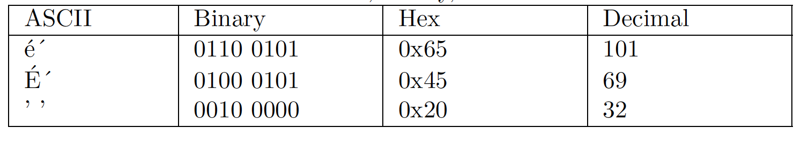
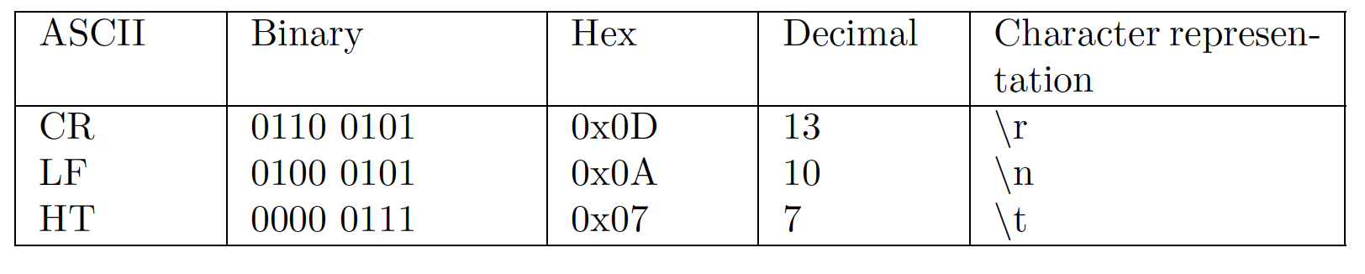
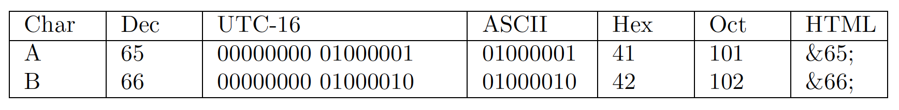
ASCII, binary, hex, …

Slide 19
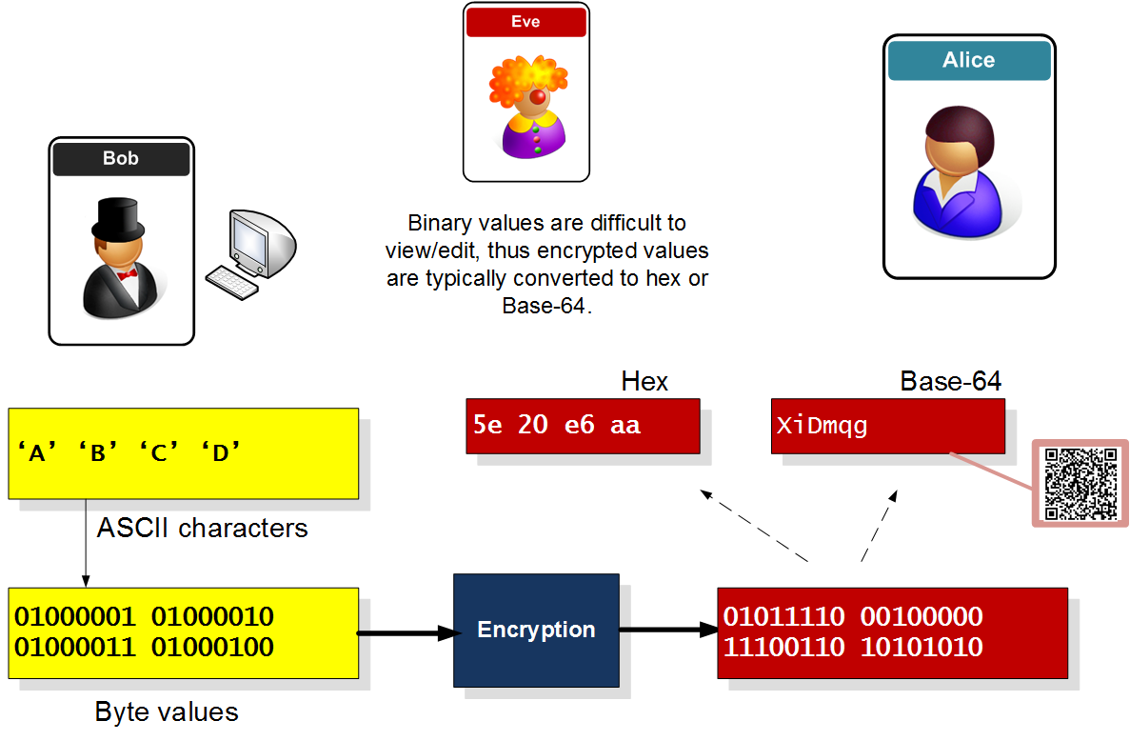
ASCII, binary, hex, …

Slide 20
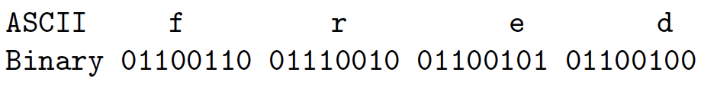
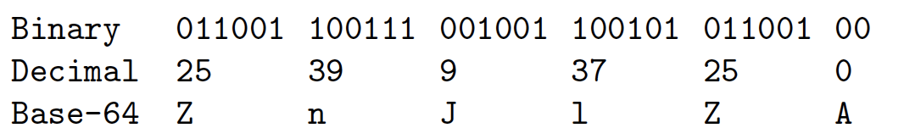
Hex and Base-64

Slide 21
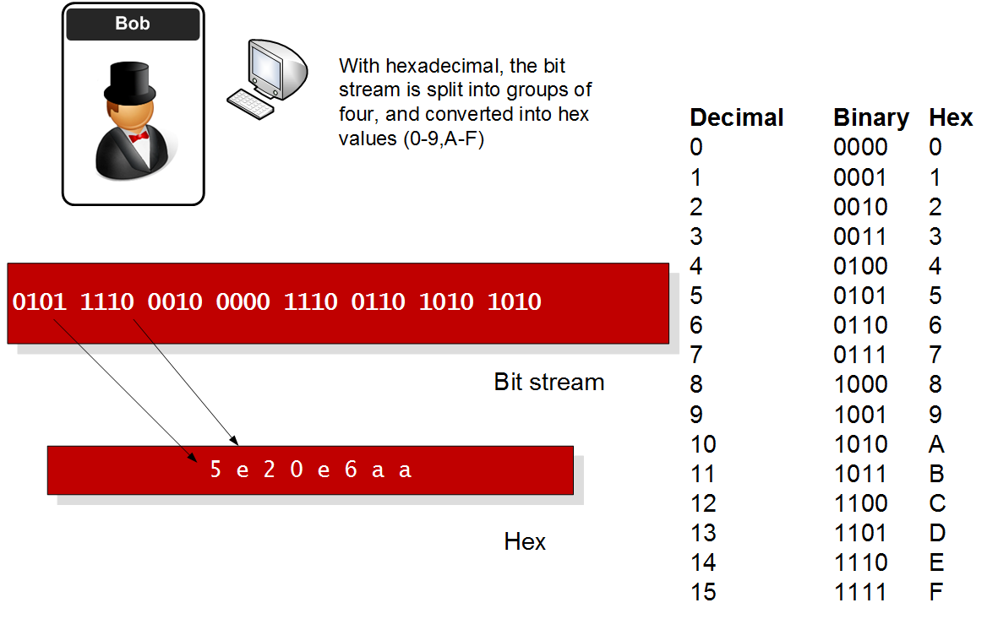
Hex

Slide 22
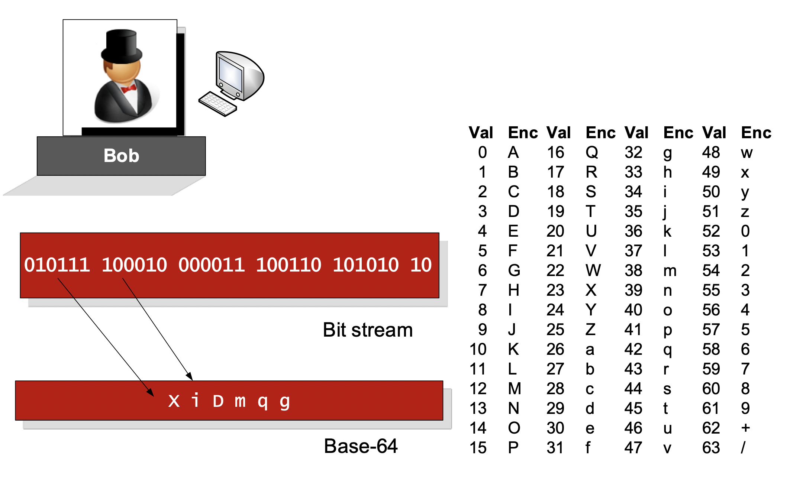
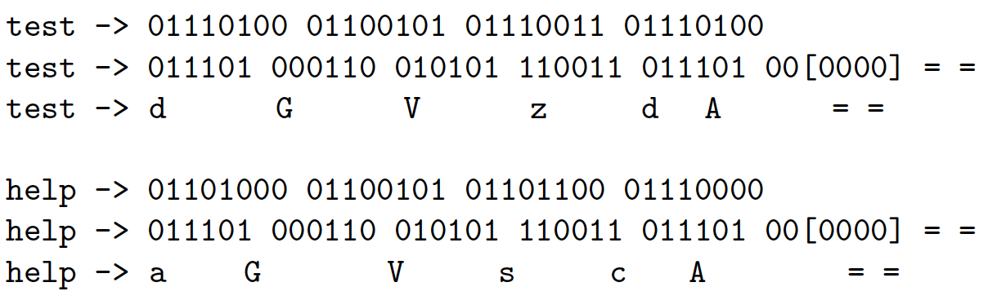
Base-64

Slide 23
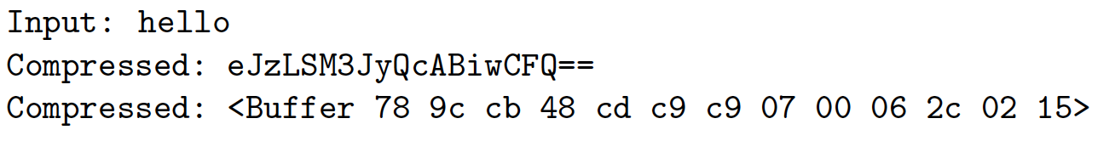
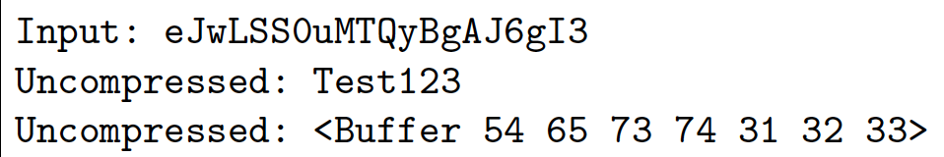
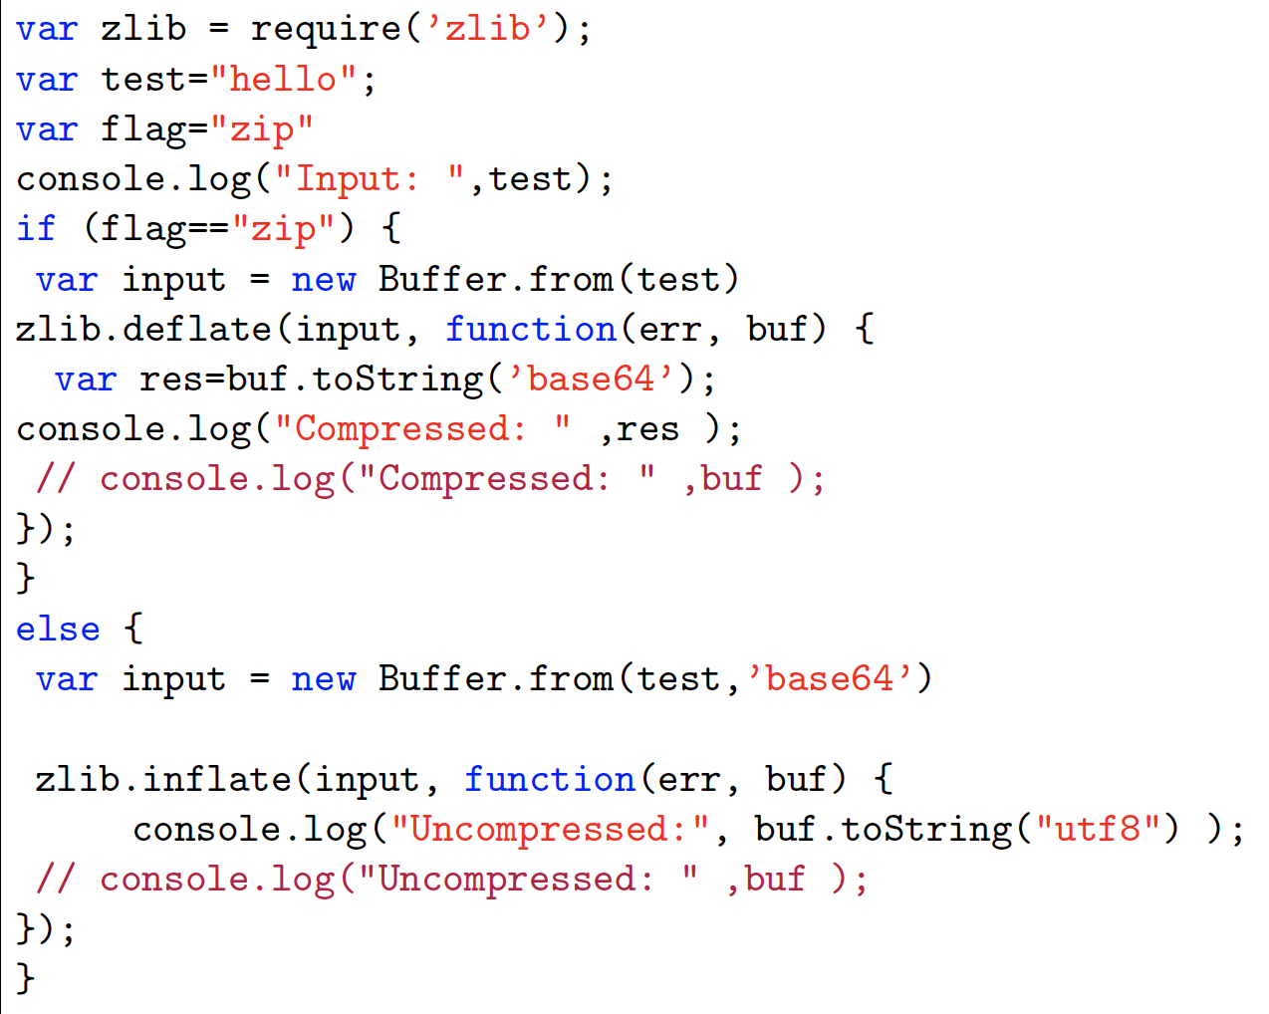
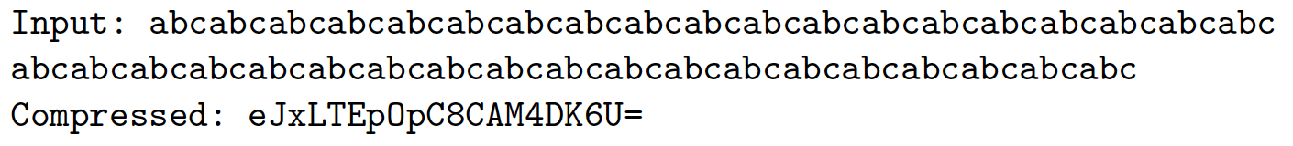
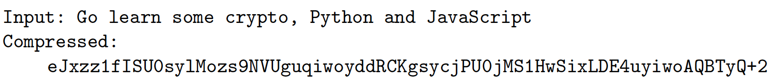
Compression

Slide 24
Magic Numbers
“From bits to information”

Slide 25
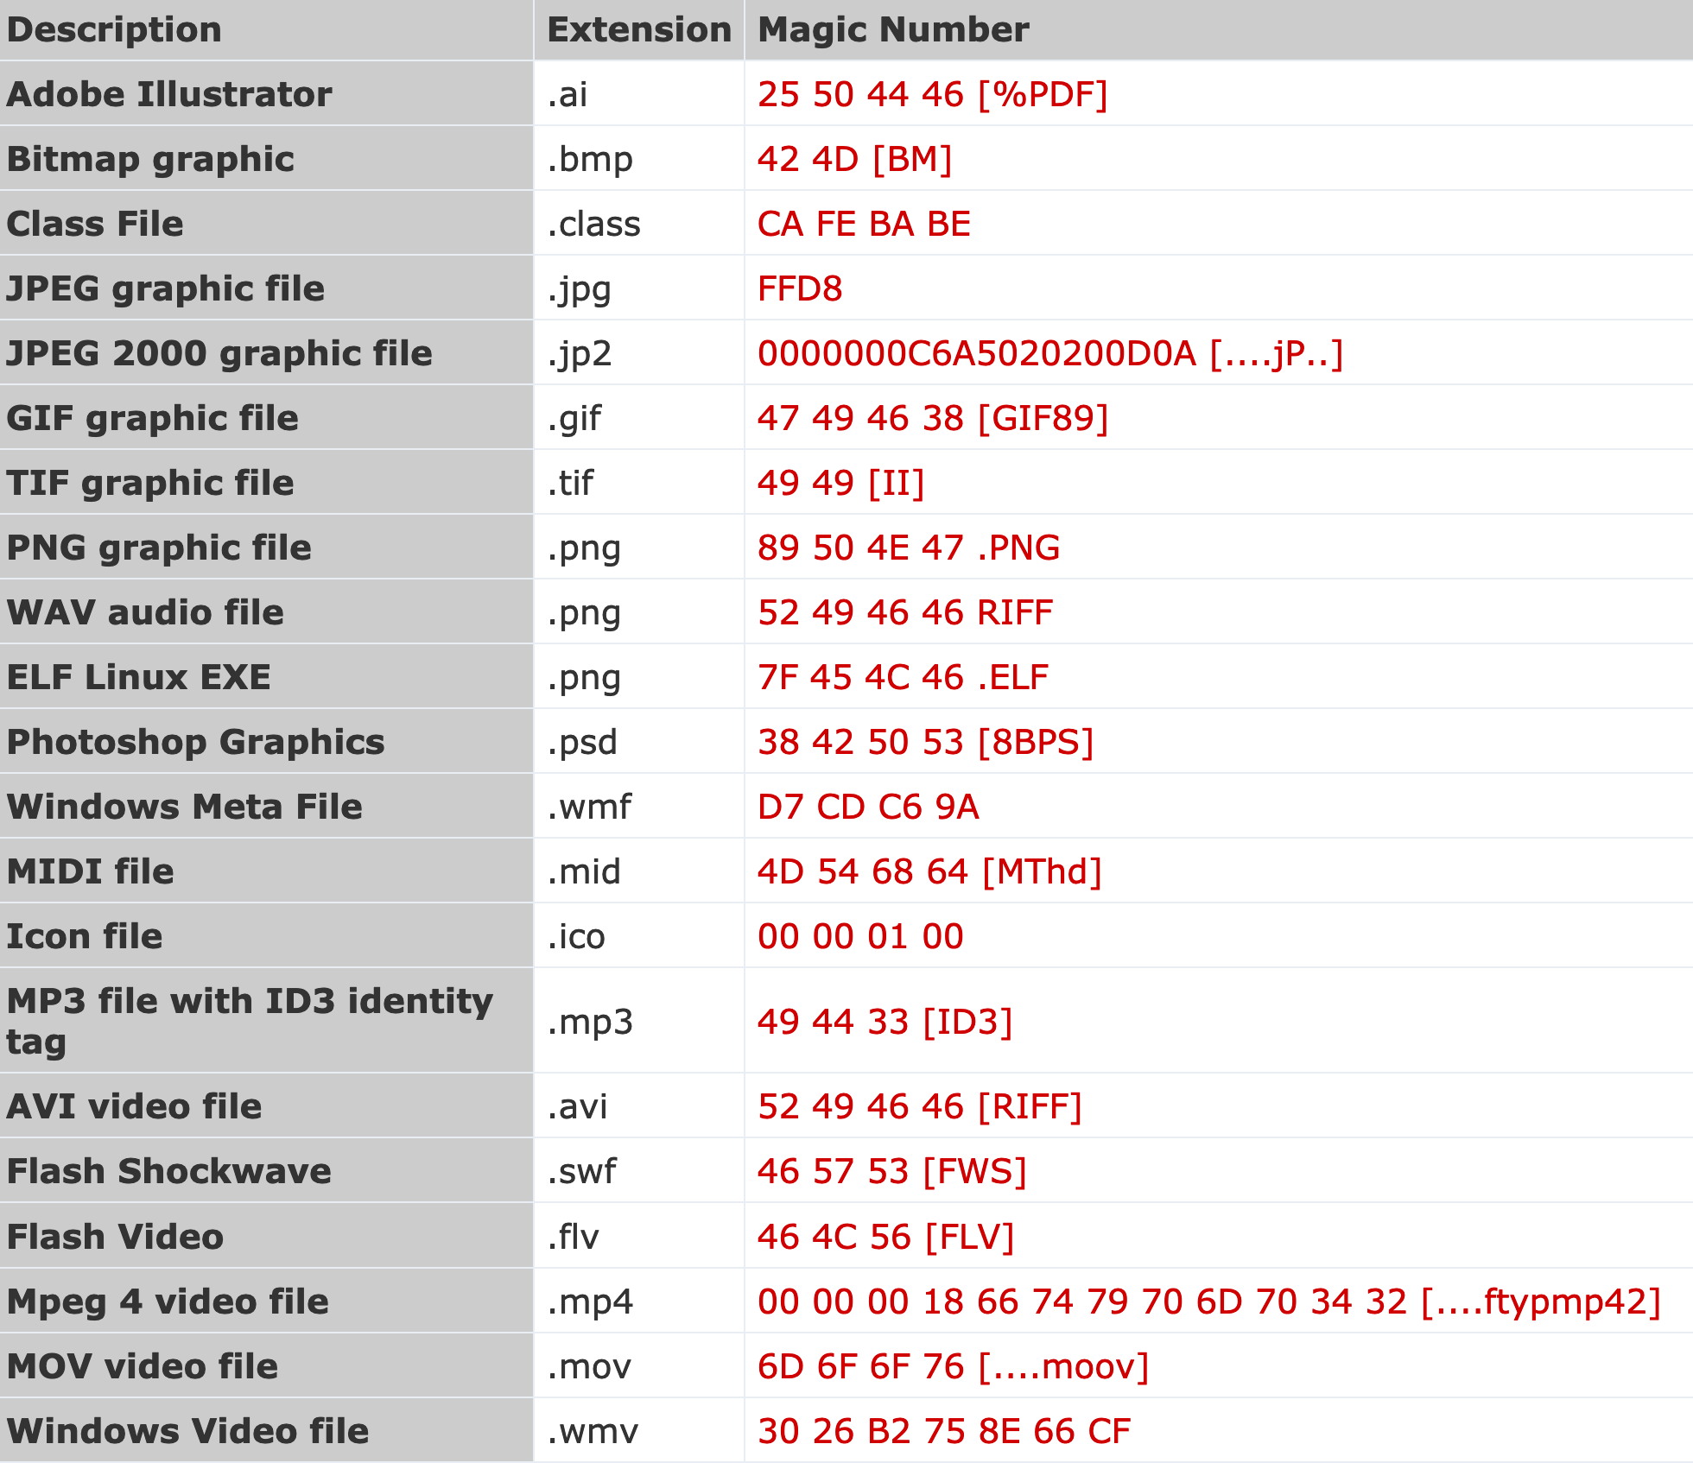
Magic Numbers

Slide 26
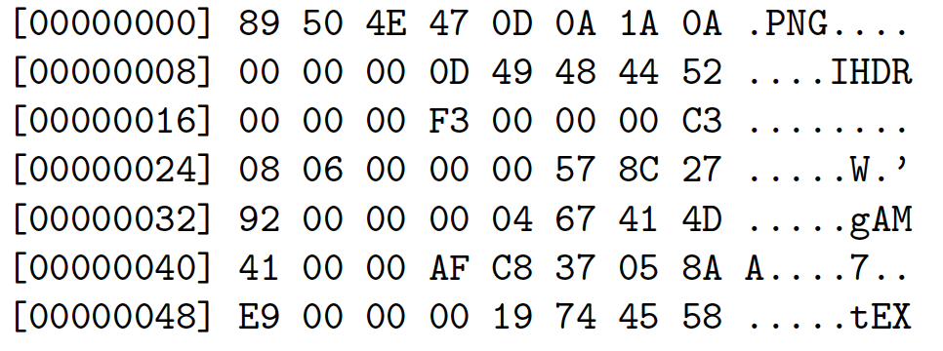
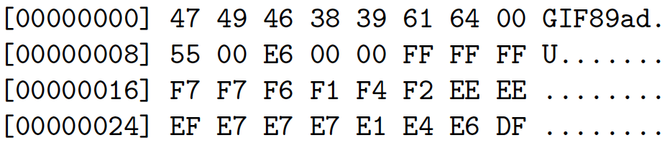
Gzip, PNG and GIF

Slide 27
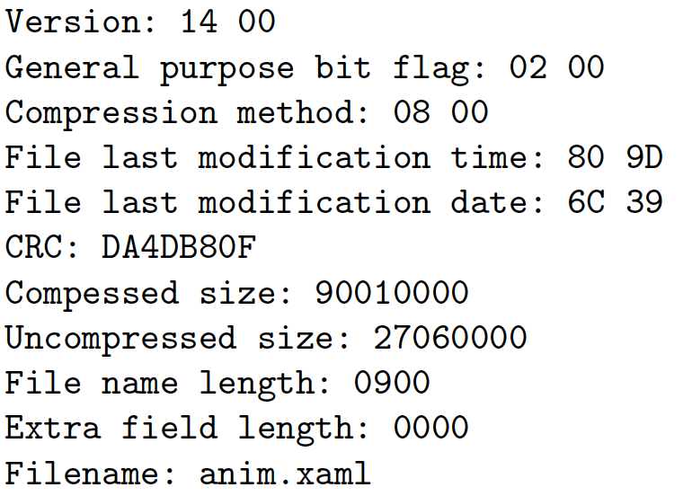
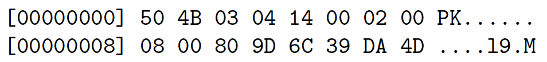
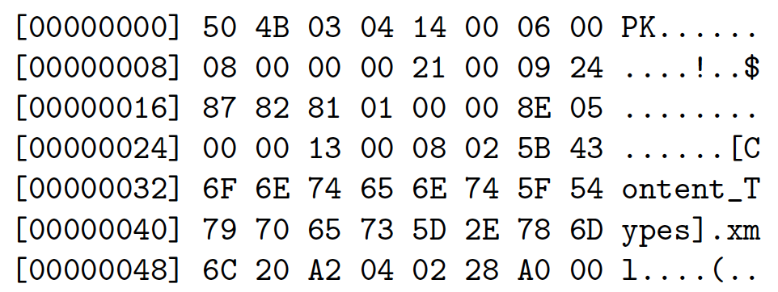
PKZip and Office XML

Slide 28
So What Is Data?
“From bits to information”

